Slide 1

GEOG 4/590: Geospatial Data Science
Lecture 7: Data access
Email: jryan4@uoregon.edu
Office: 163A Condon Hall
Office hours: Monday 15:00-16:00 and Tuesday 14:00-15:00

Slide 2
Max/Anna A/Isaac: Tsunami evacuation from the Oregon coast
Emerson: Rainfall and household water supply
Hana: Vegetation recovery times in response to fire regimes/disturbances in Siberia
Dalton/Timmy/Shauny: Coastal erosion/water levels in the Great Lakes region
Addy/Kelly: Ice breakup in the Yukon River Delta
Haley/Lauren/Kent/Anna J: Grocery store access in Eugene via public transport
Jasper/Sam F/Bowie: Short and long-term vegetation recovery post-wildfire
Ethan: School funding and education outcomes
Adamaryz: Rural access to higher education
Parker: Barriers to lamprey fish migration
Sam G: Tracking neighborhood cat using GPS
Devlin: Hillslope analysis from LiDAR data

Slide 3
No assignment this week!
Recommend that time is used to get started on projects
Directory structure
Package installations
GitHub workflow
Data!
We will check-in next week to make sure everyone has data and a plan
Designate a team leader and assign tasks to team members

Slide 4
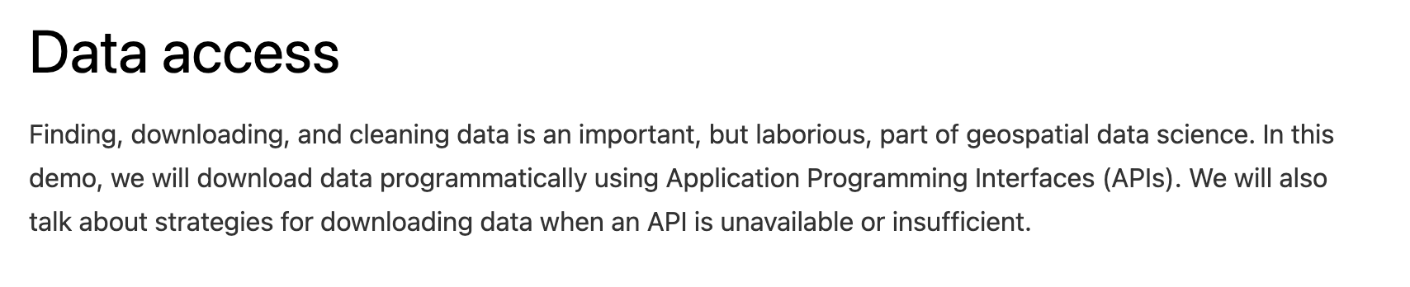

Slide 5
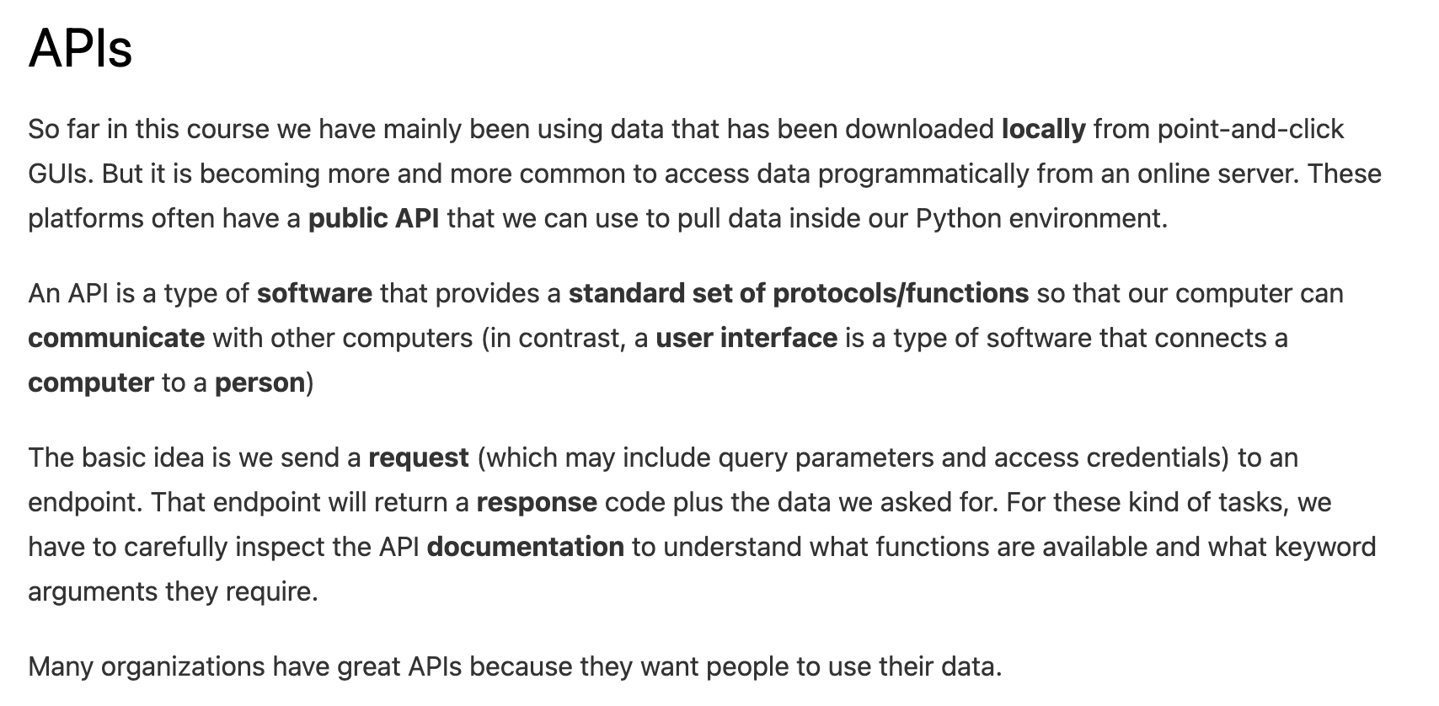

Slide 9
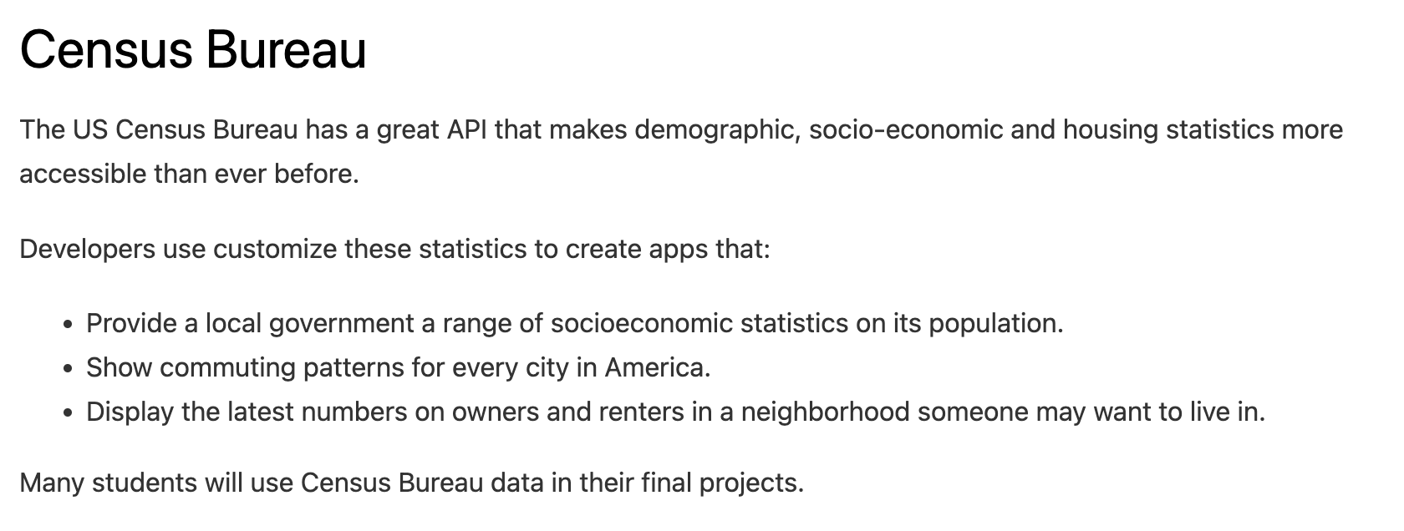

Slide 10
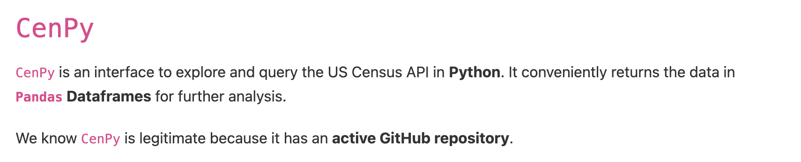

Slide 11
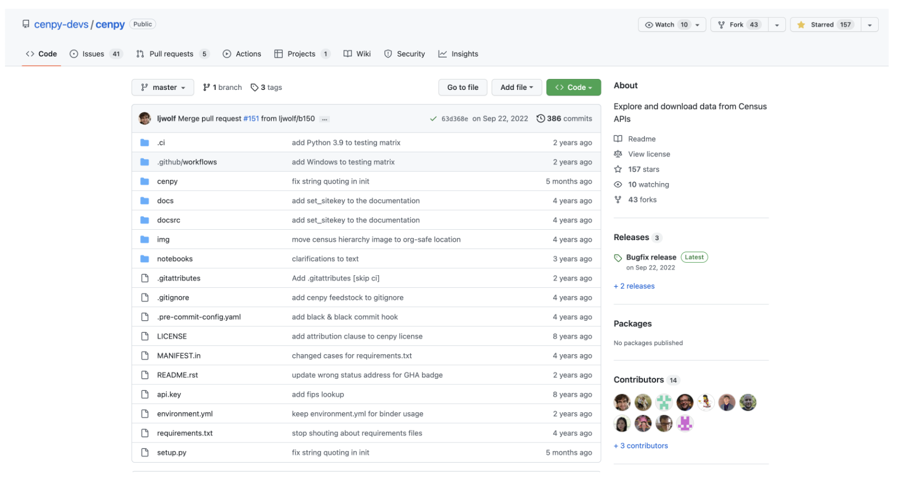

Slide 12
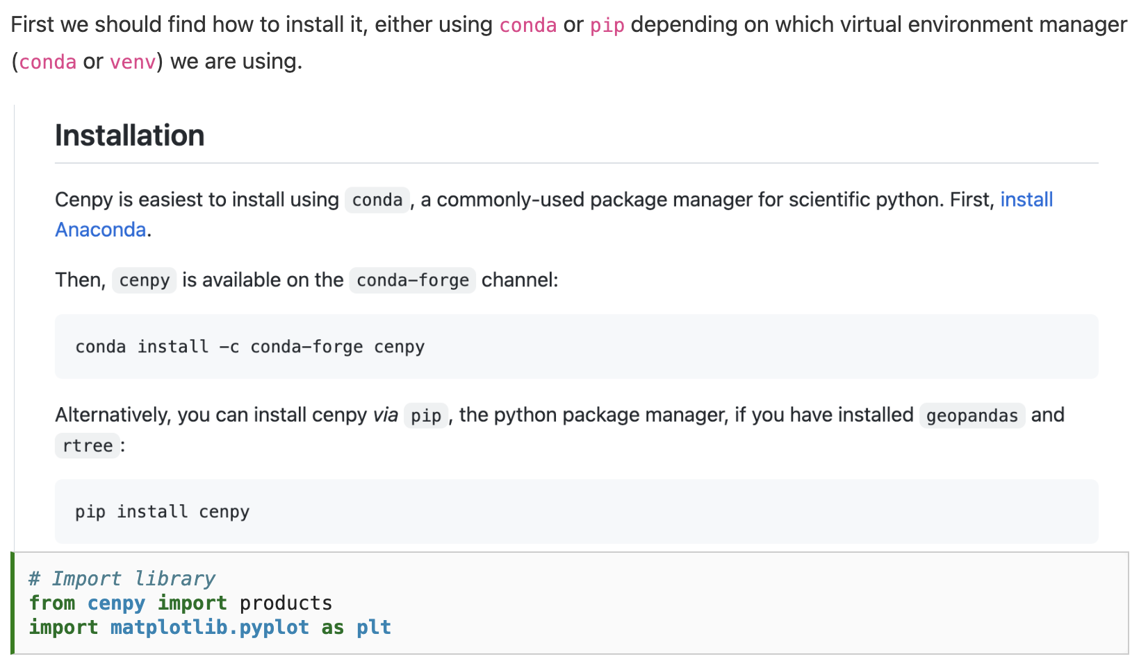

Slide 15
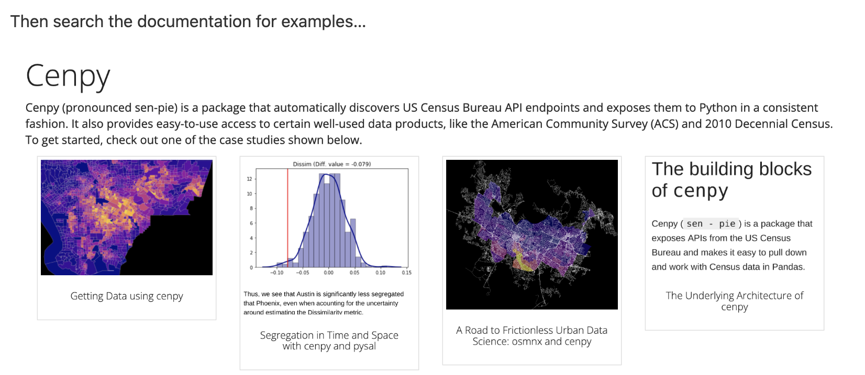

Slide 16
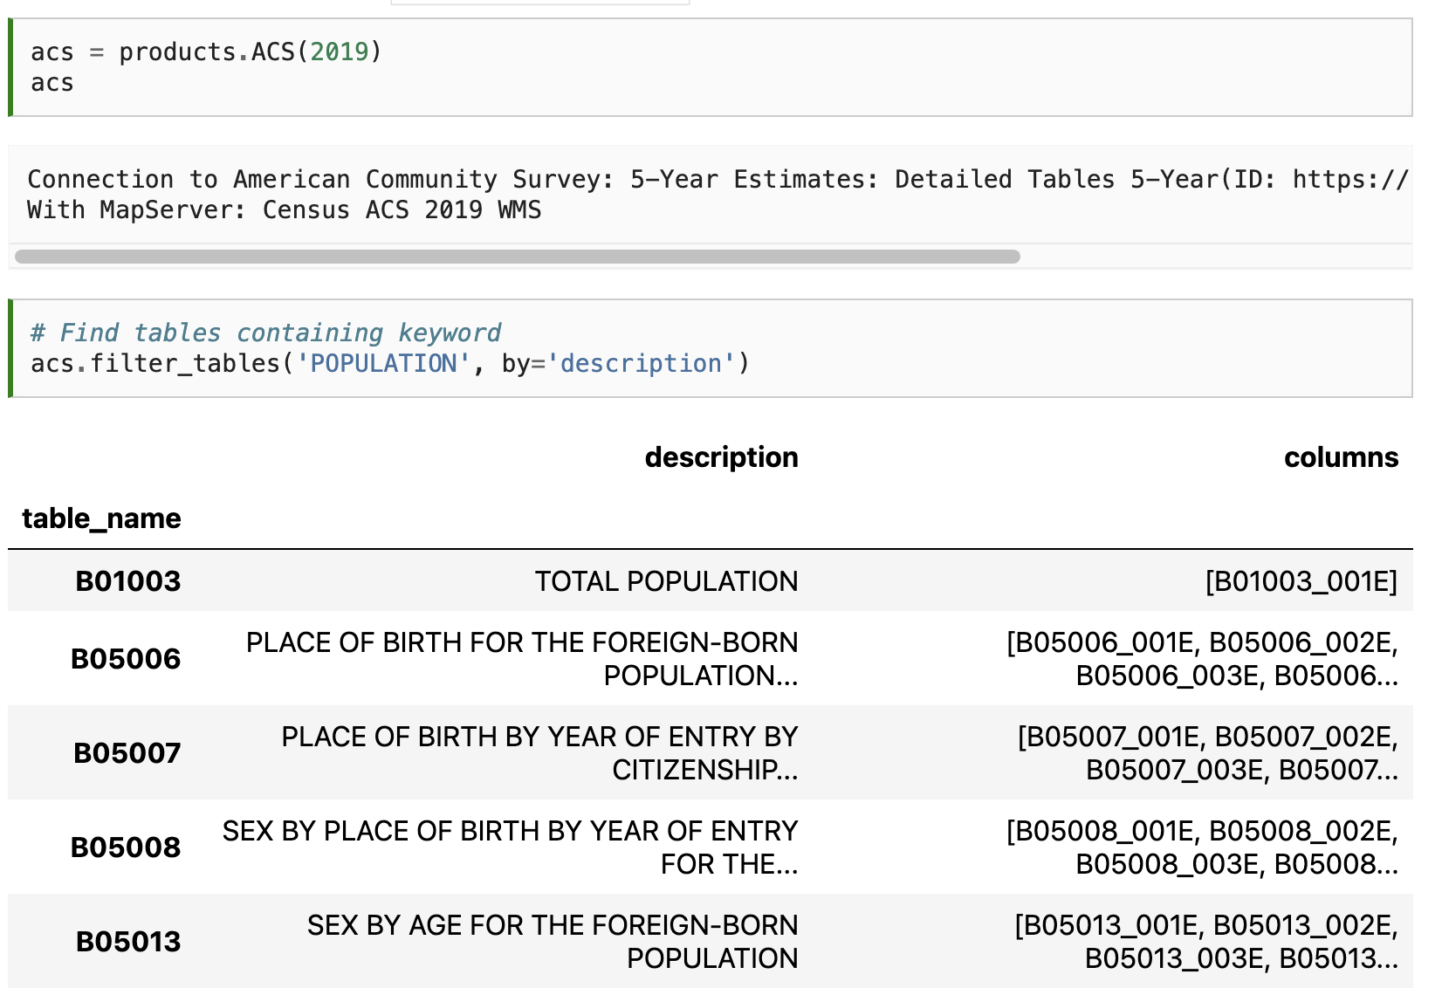

Slide 18
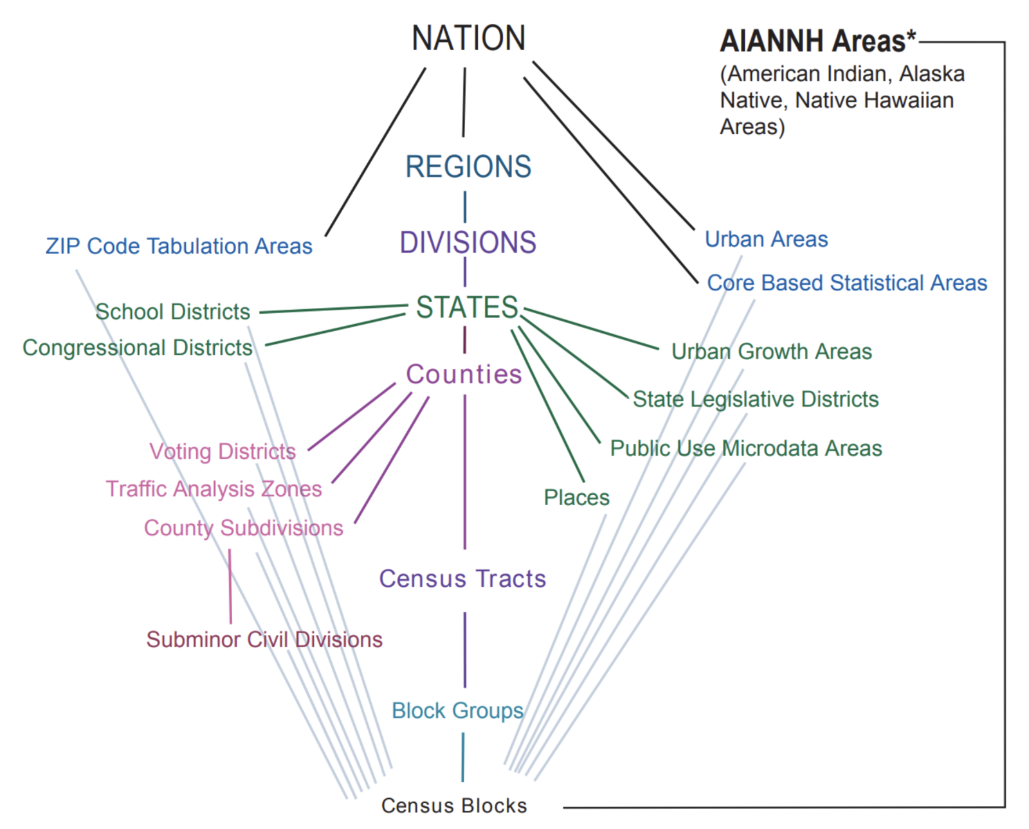

Slide 19
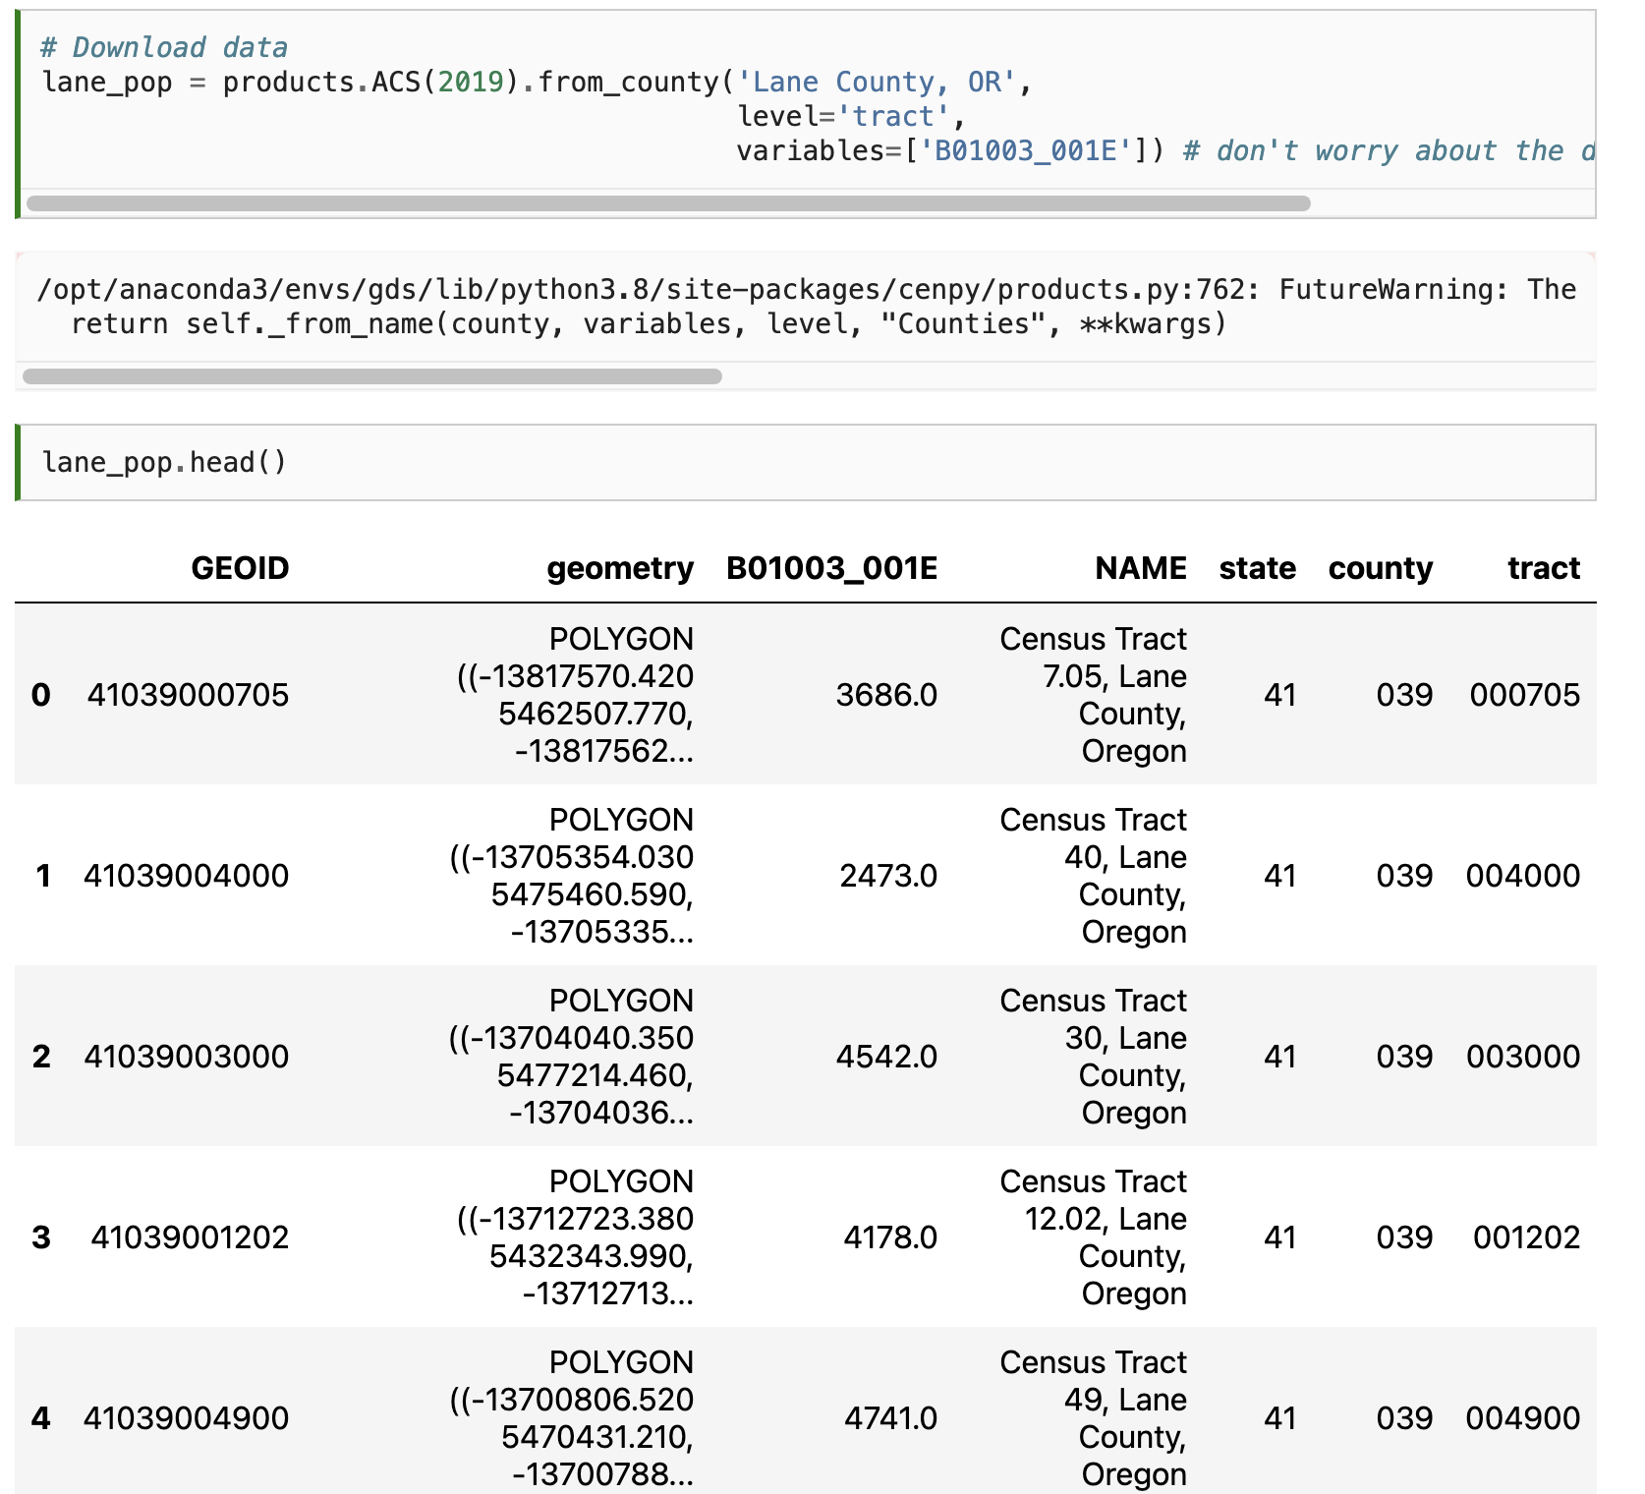

Slide 21
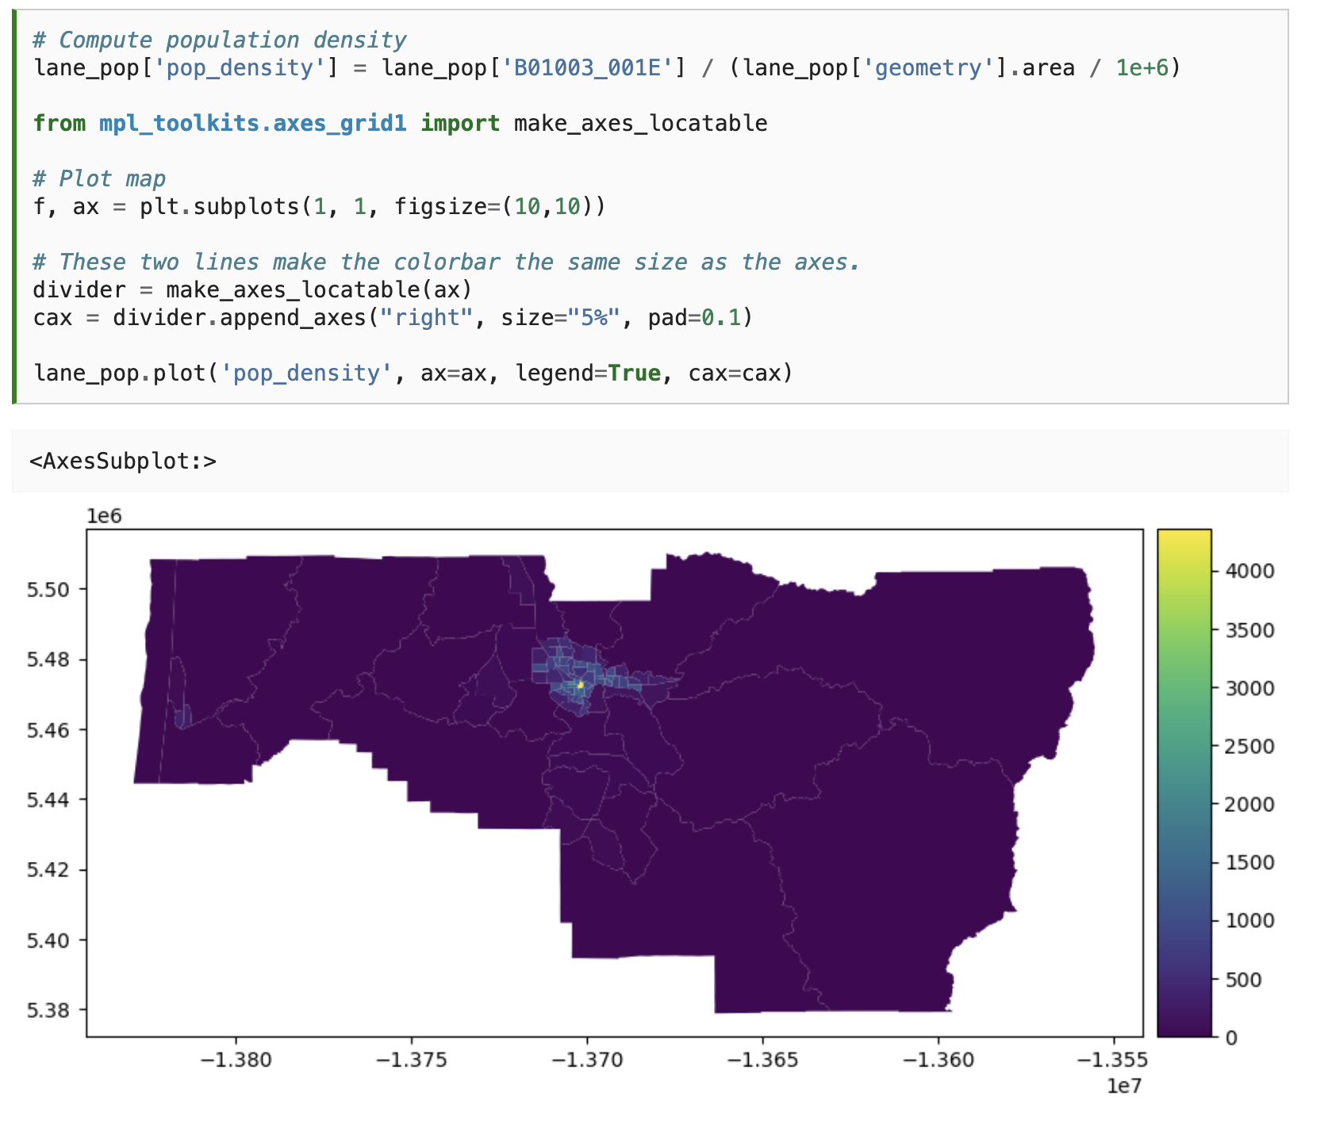

Slide 22
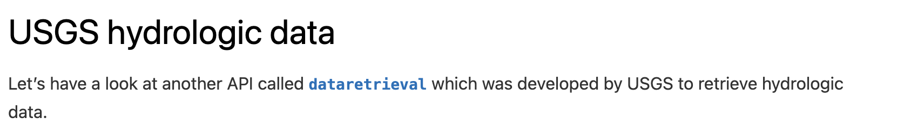

Slide 23
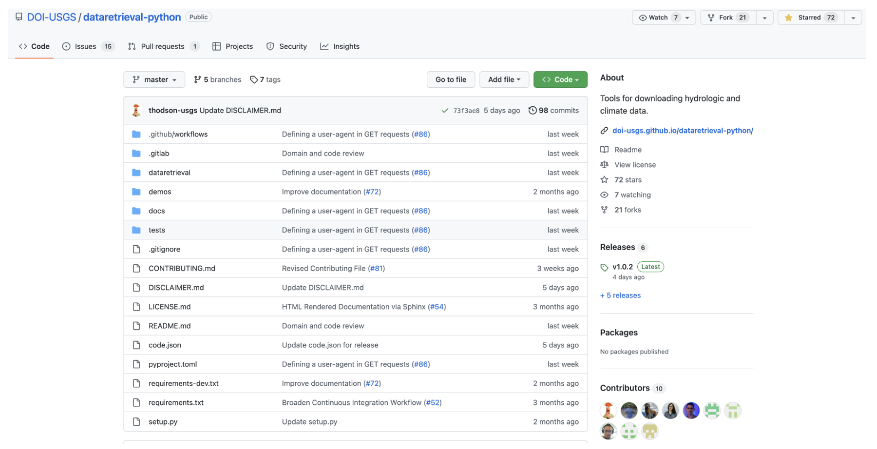

Slide 24
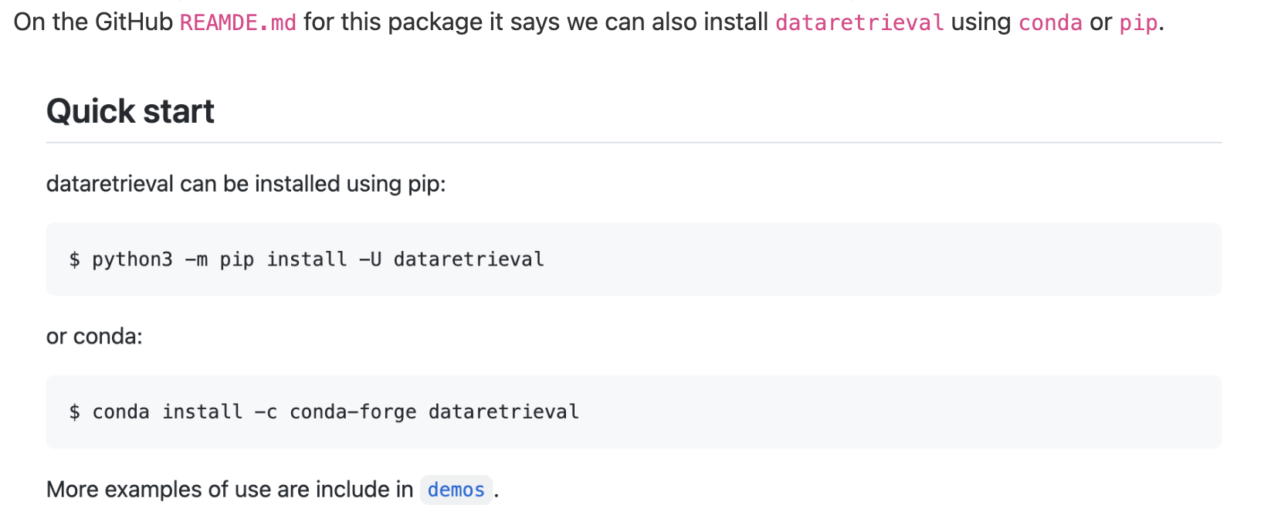

Slide 25
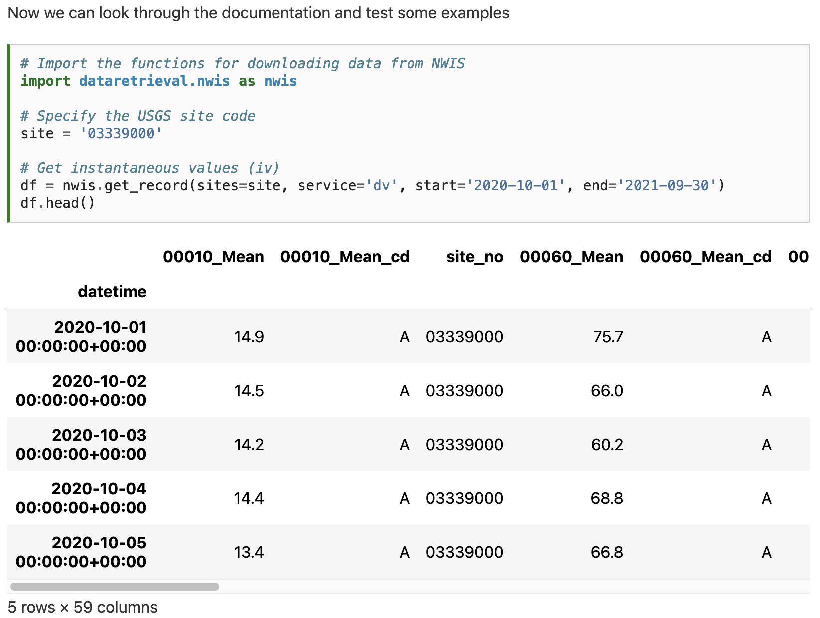

Slide 26
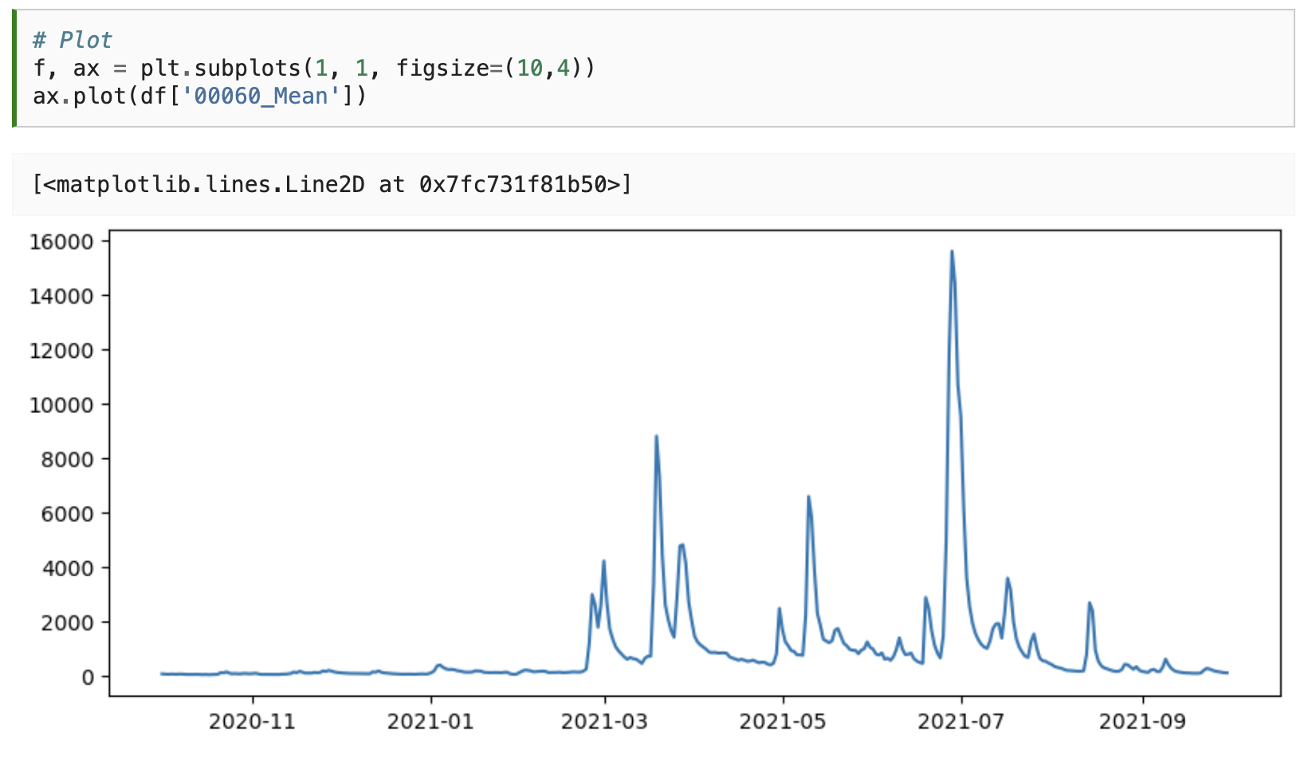

Slide 27
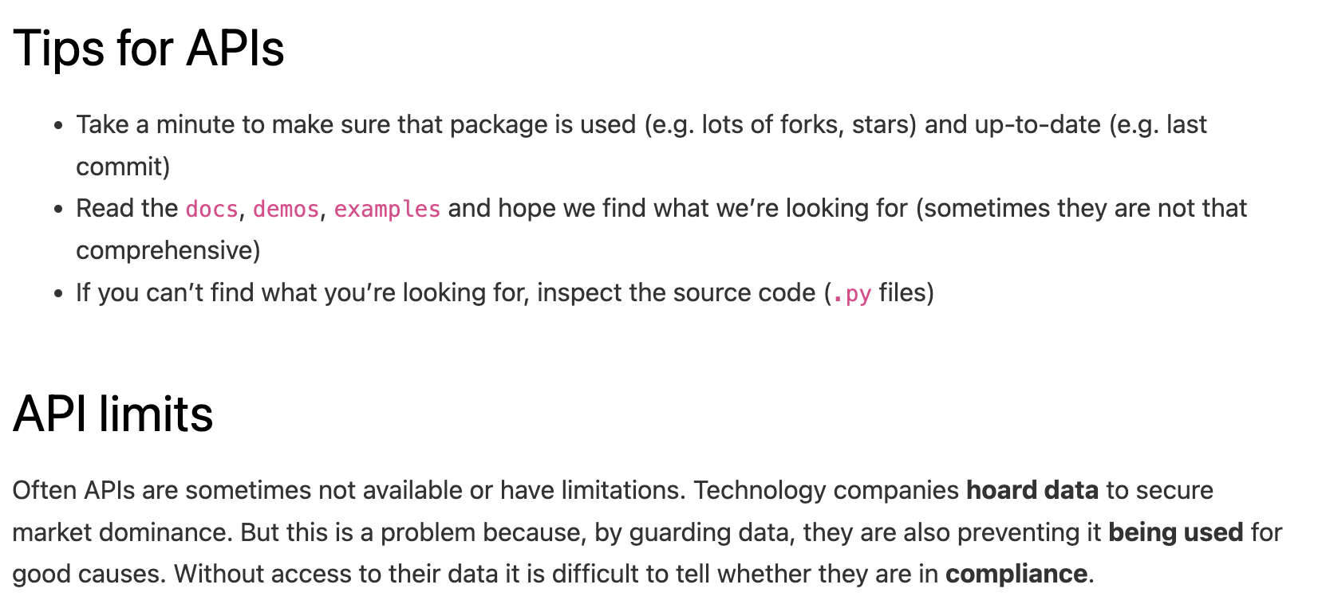

Slide 29
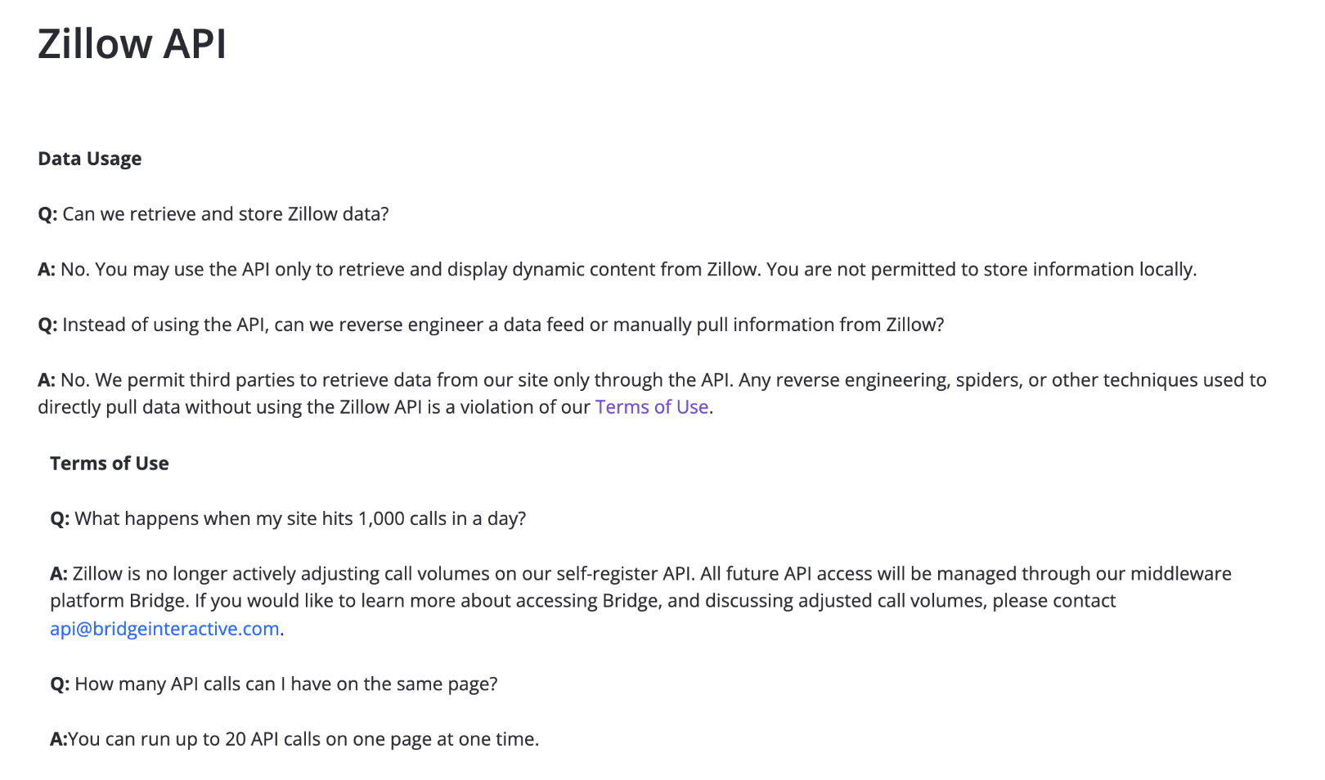

Slide 31
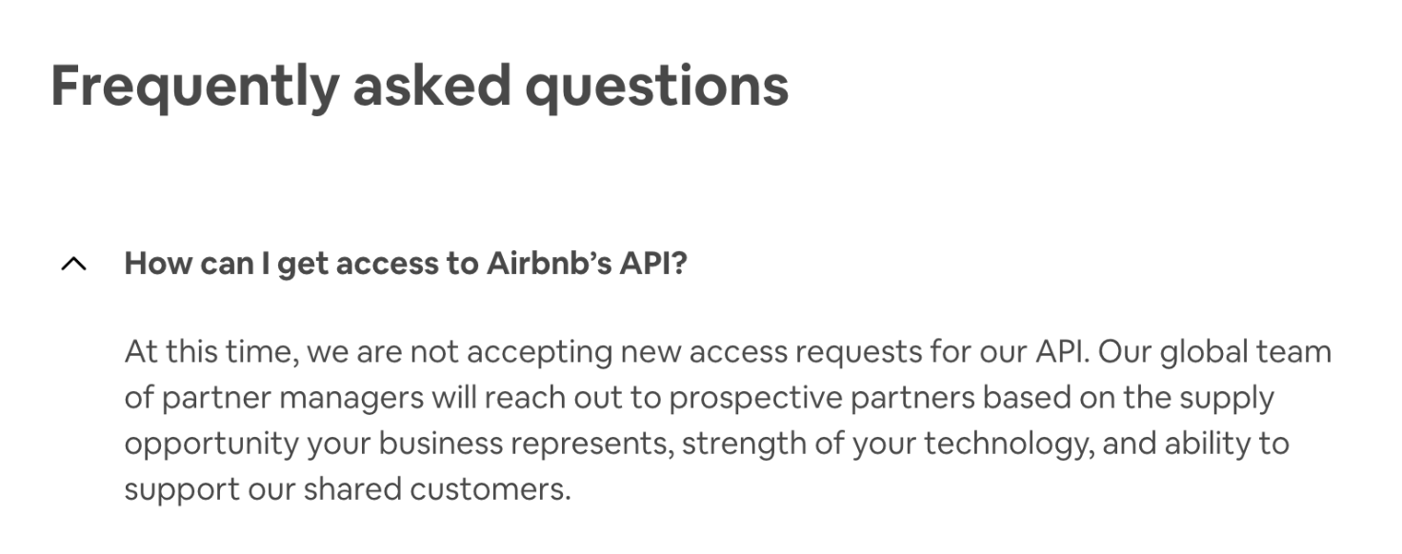

Slide 32
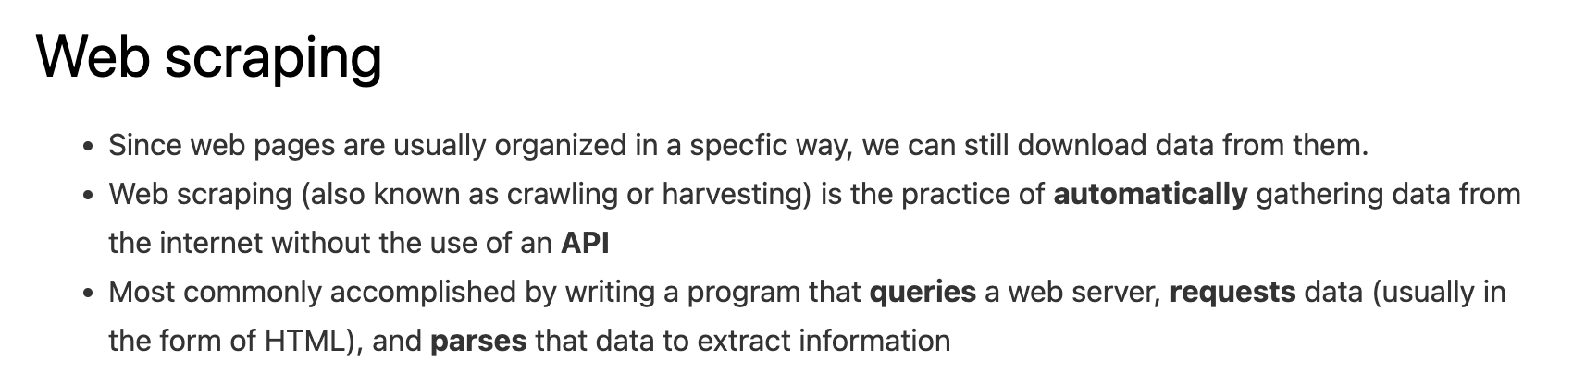

Slide 33
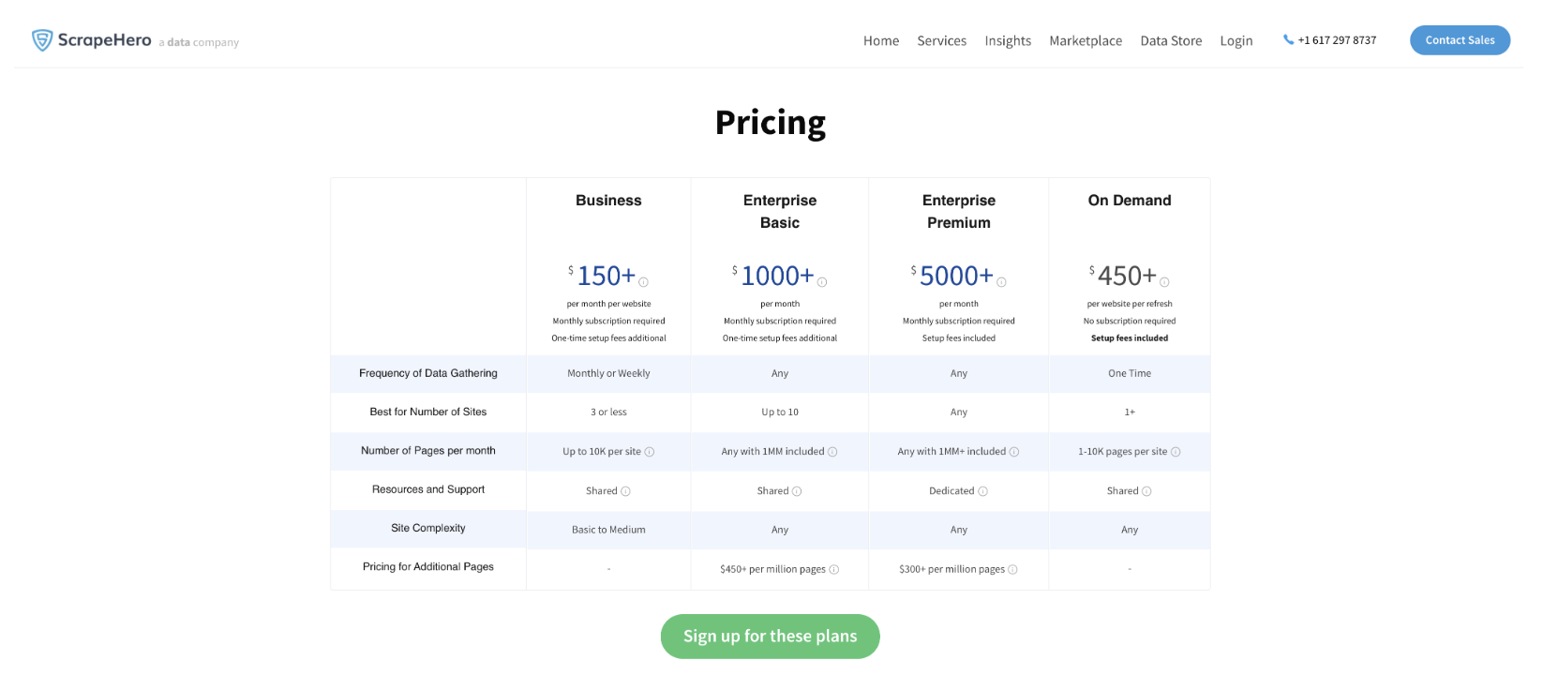

Slide 34
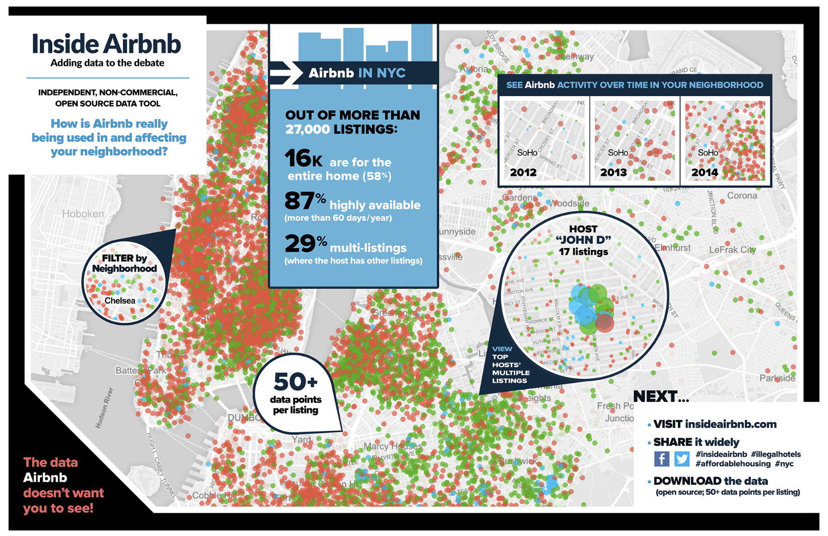
Notes:
Vigilantes showing that AirBnBs were not in compliance.

Slide 35
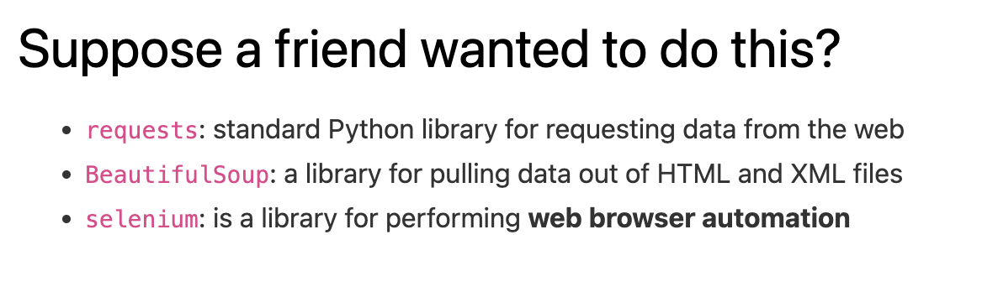

Slide 36
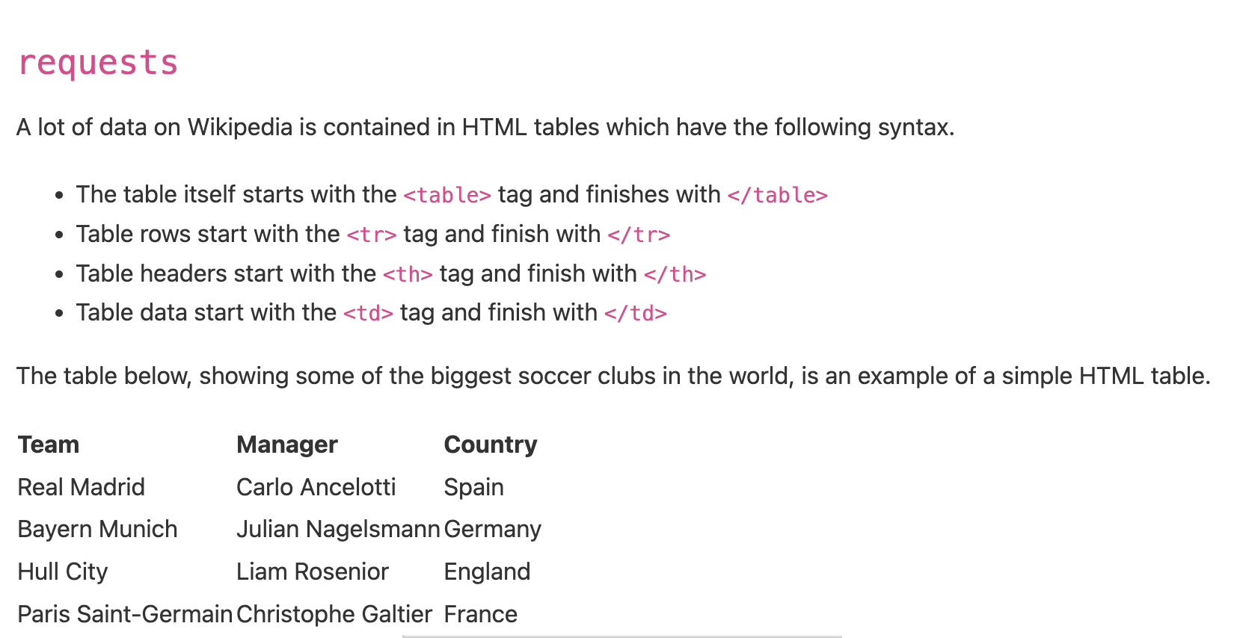

Slide 37
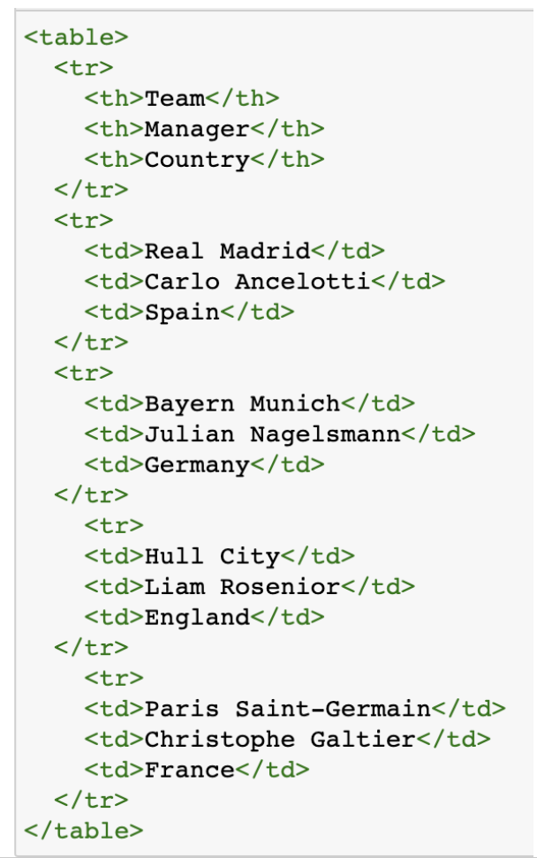

Slide 38
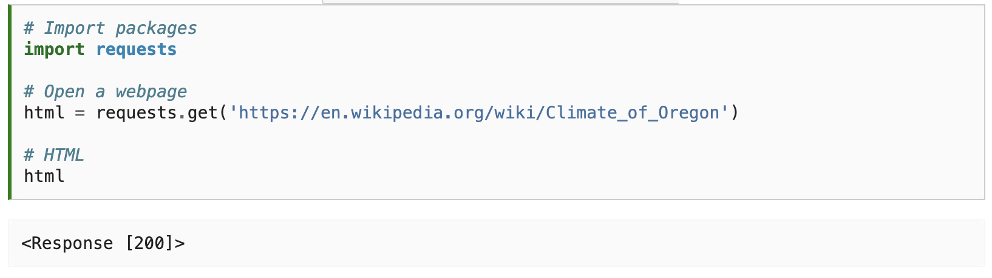

Slide 39
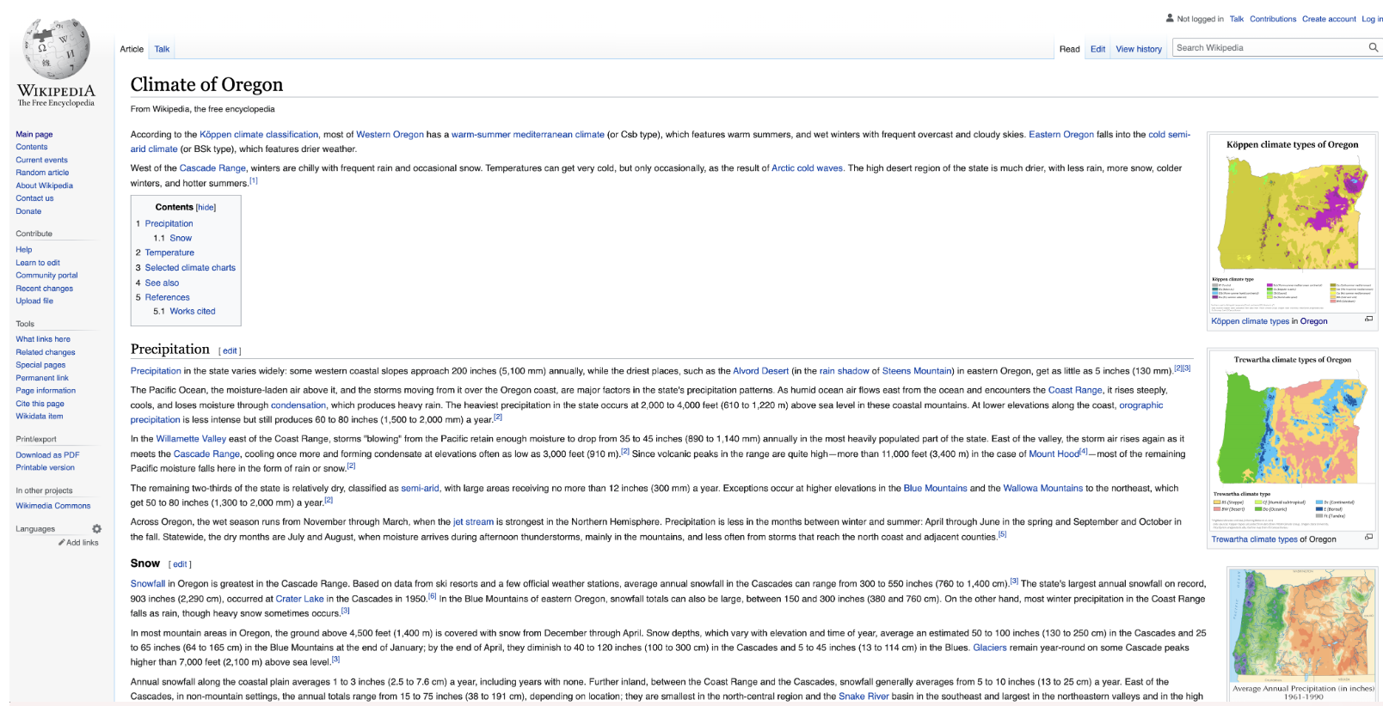

Slide 40
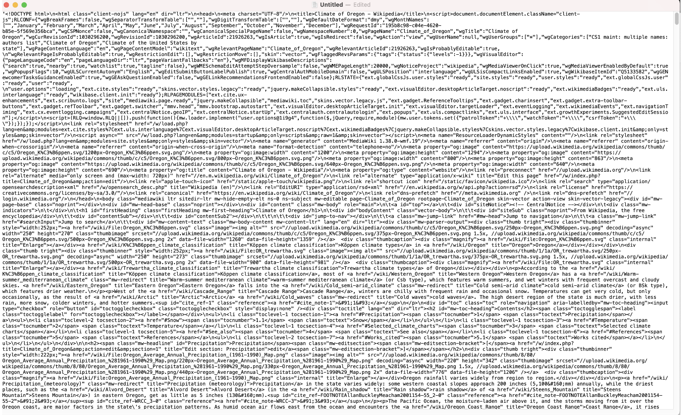

Slide 41
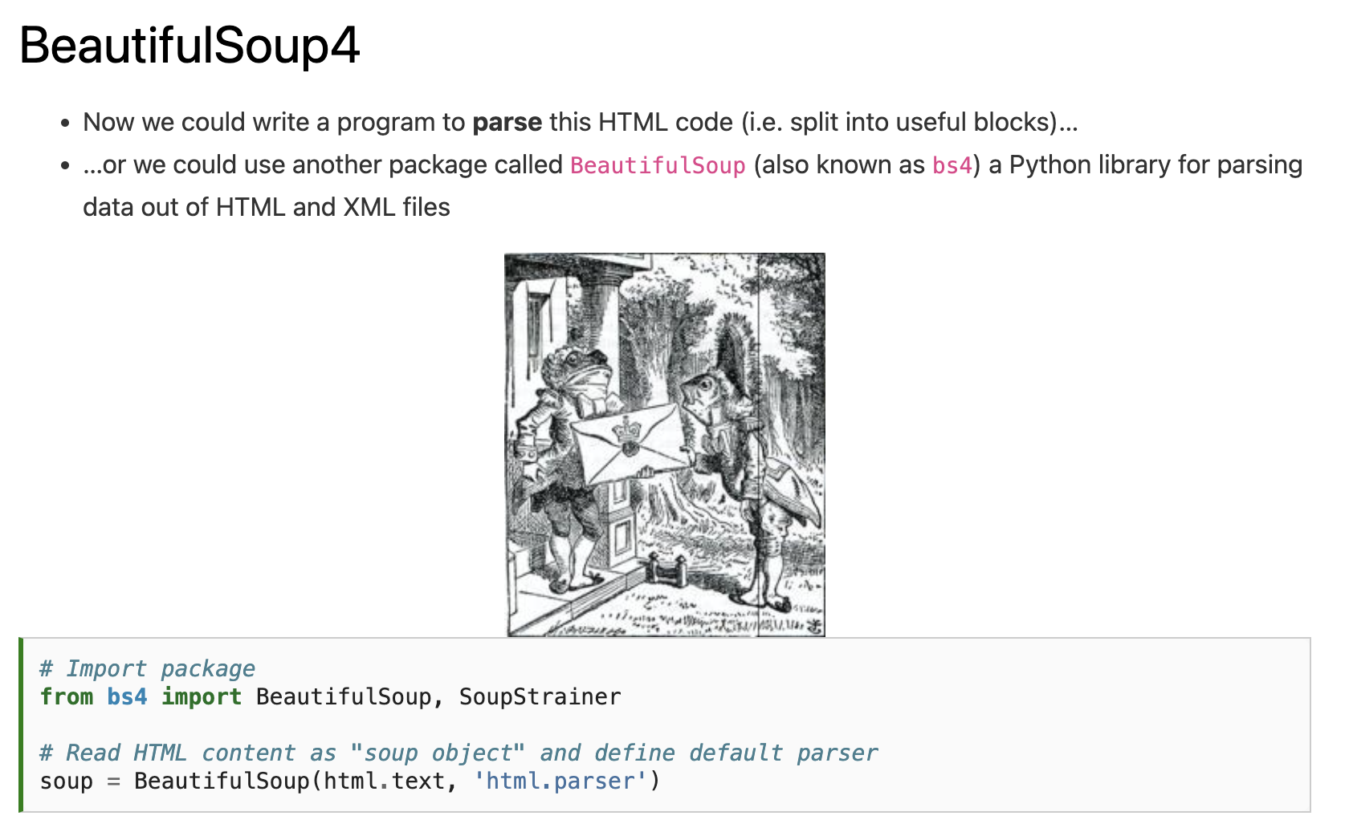

Slide 43
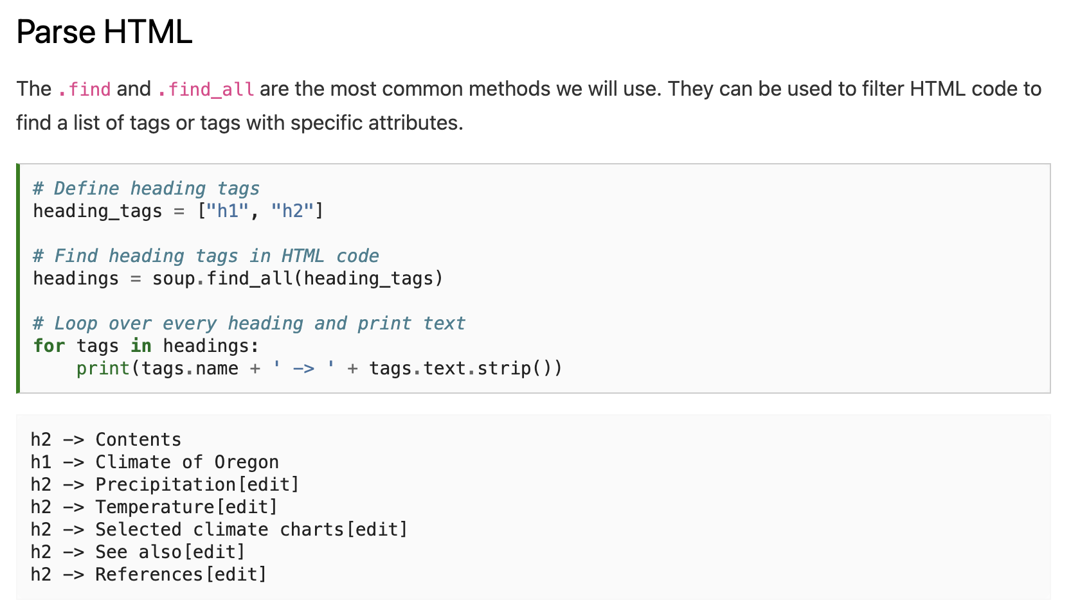

Slide 45
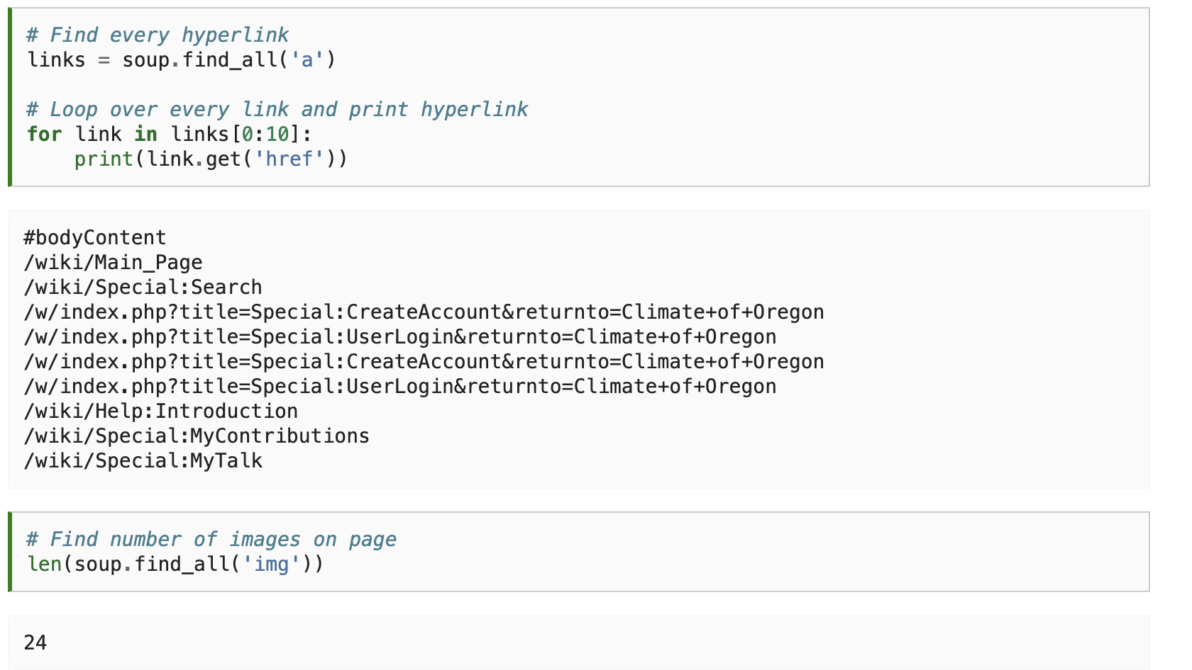

Slide 47
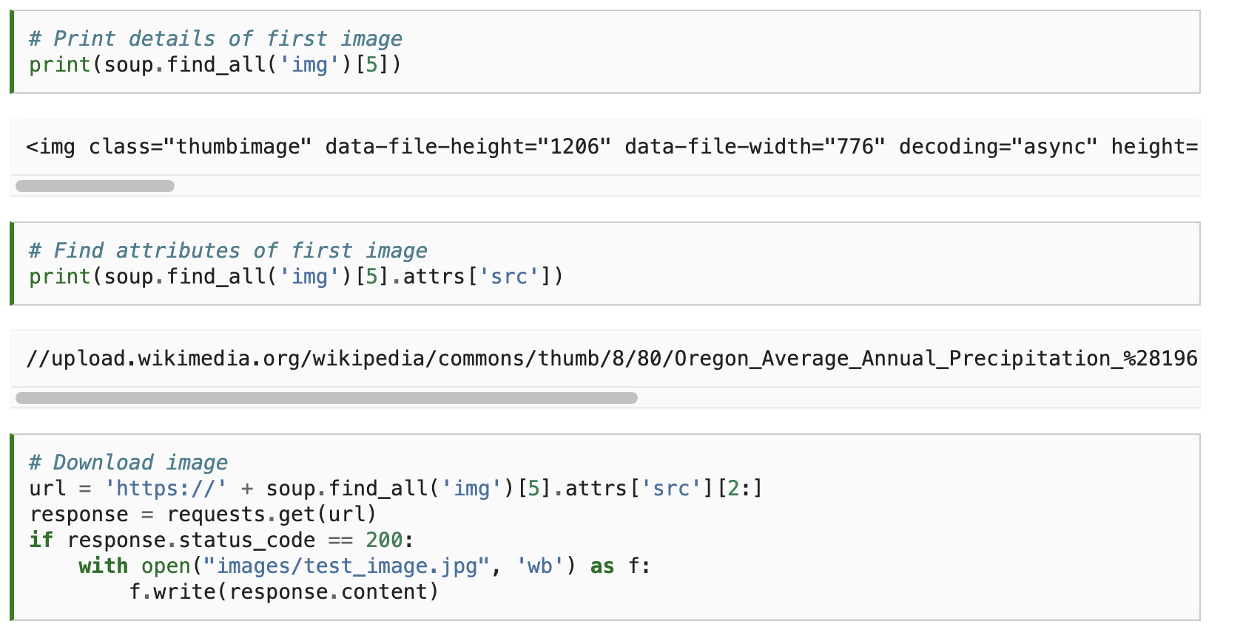

Slide 49
Notes:
Vigilantes showing that AirBnBs were not in compliance.

Slide 50
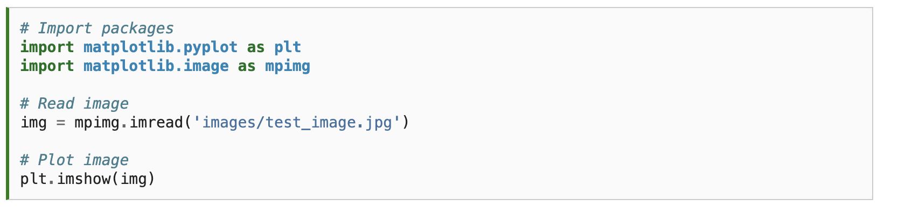
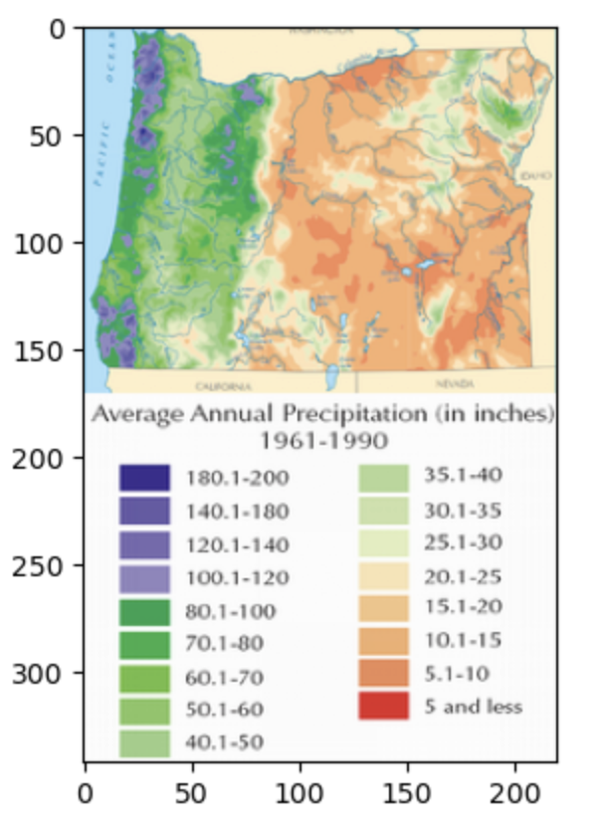

Slide 51
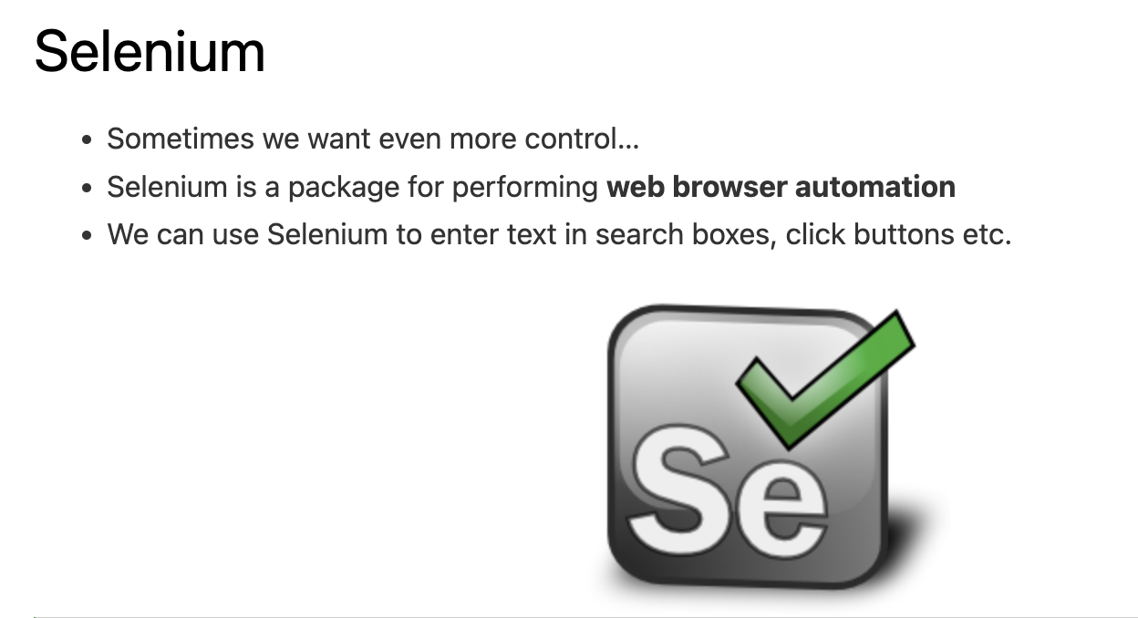

Slide 52
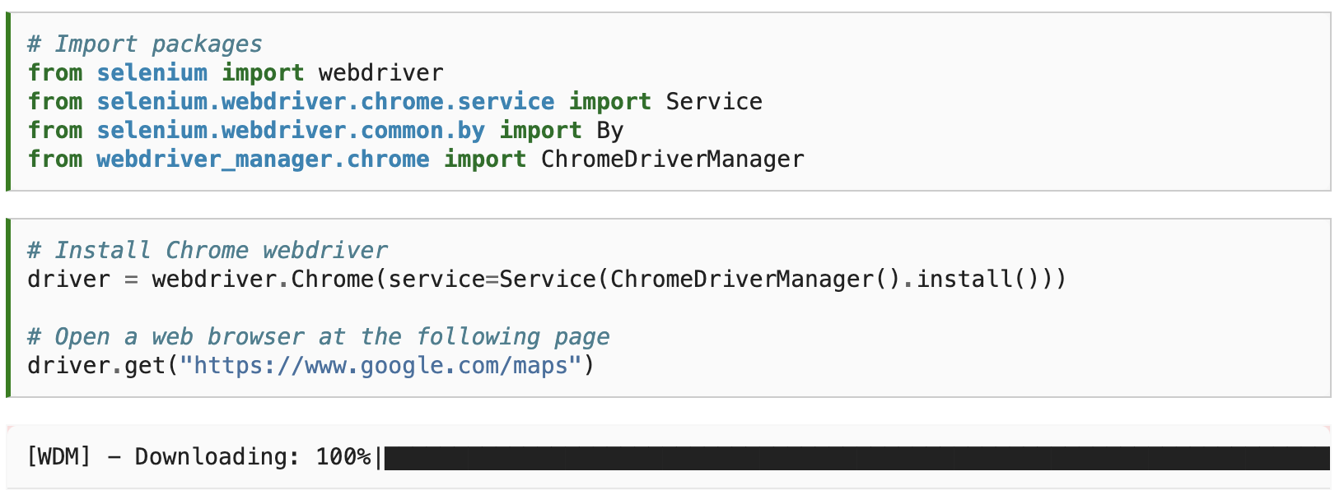

Slide 53
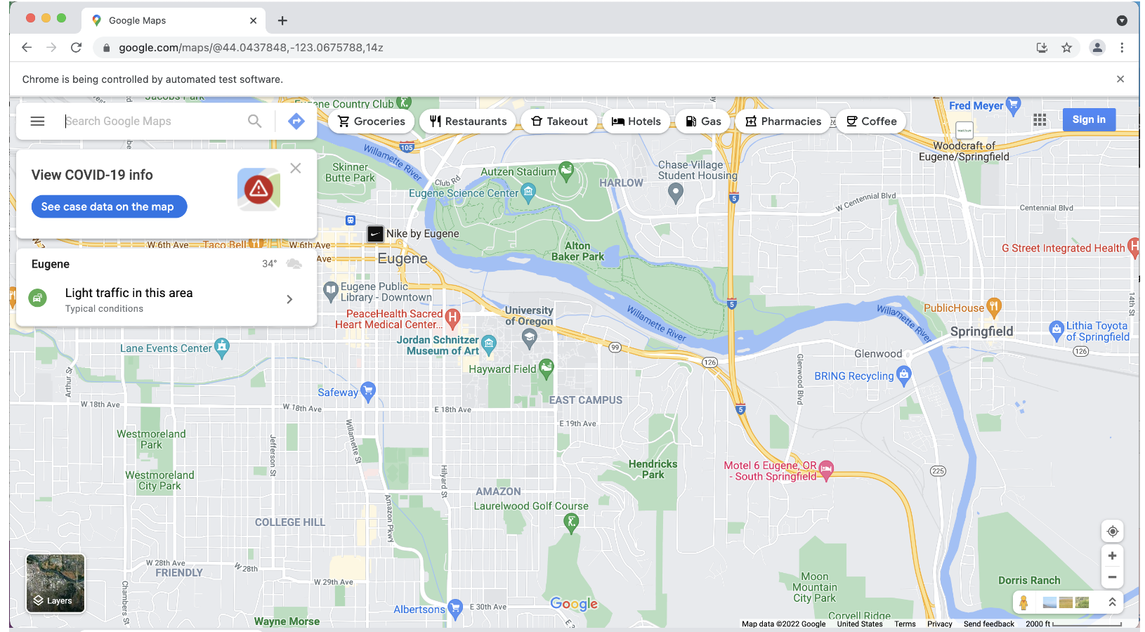

Slide 54
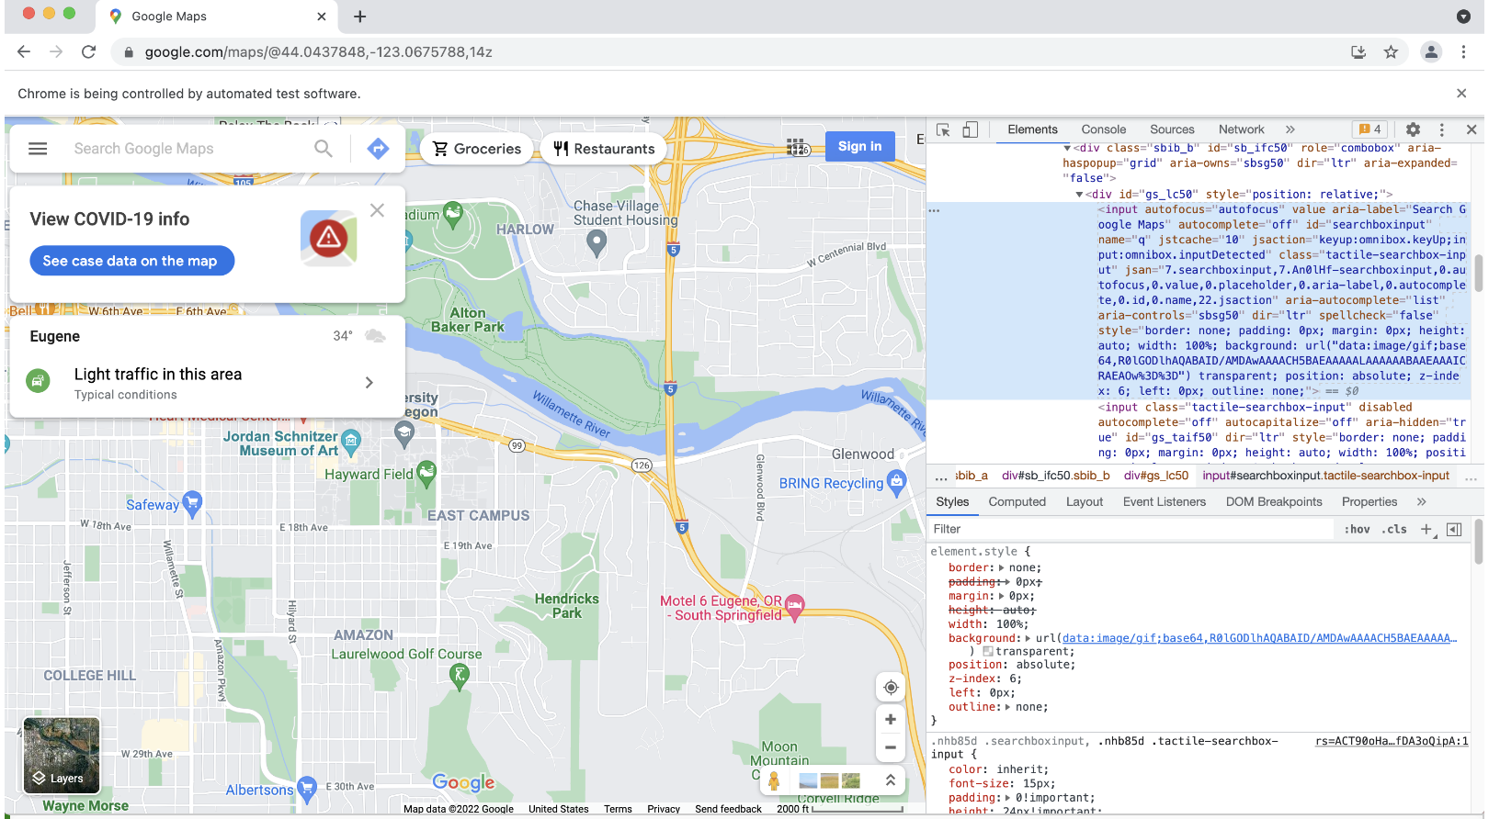
Notes:
Right-click → inspect

Slide 56
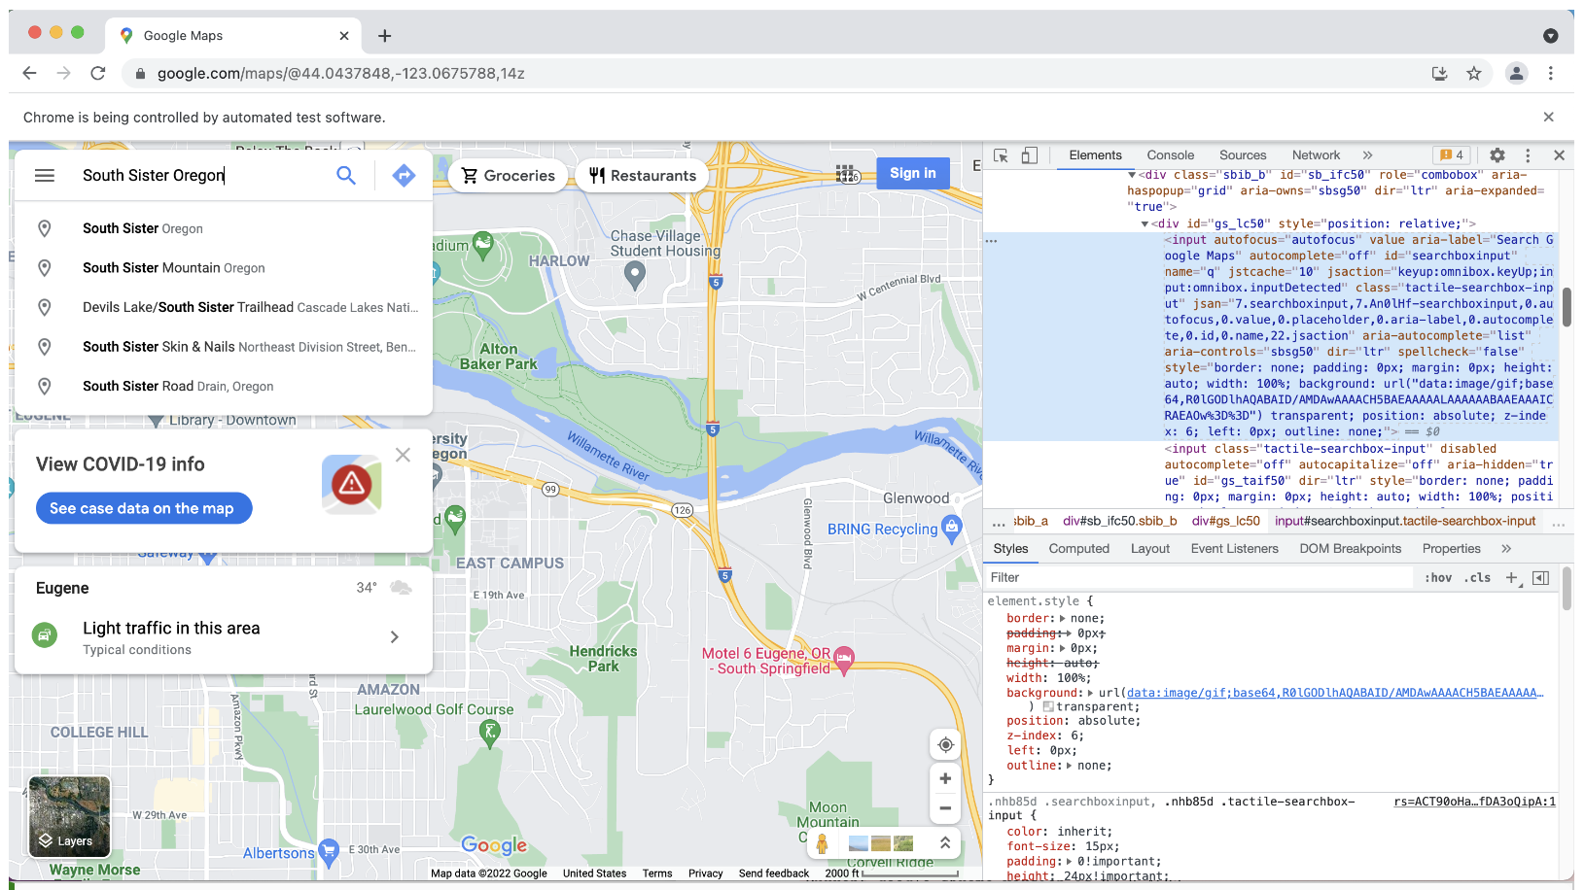

Slide 58
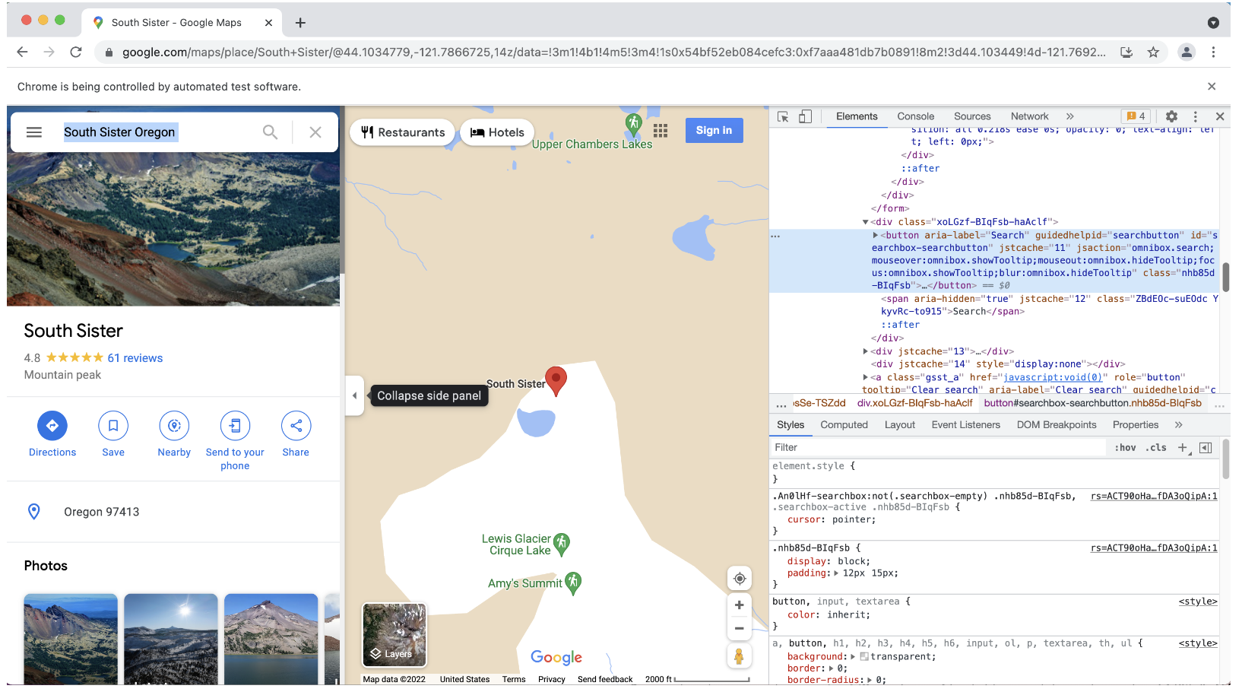

Slide 59
Next time: Careers in Geospatial Data Science
Email: jryan4@uoregon.edu
Office: 163A Condon Hall
Office hours: Monday 15:00-16:00 and Tuesday 14:00-15:00

